Slide 1

Predicting Job Change
James Anderson
Benjamin Kanarick
Rochan Nehete
Viswa Tej
MIS381N, MSBA-2023, The University of Texas at Austin

Slide 2
Predicting whether or not an employee intends to leave their job|A data science company wants to identify projected attrition rate based on specific candidate / current employee characteristics.
Predictor Variables
Target Outcomes
Relevant Experience
Experience (years)
Current Company Size
Company Type
Gender
Education Level
1: Candidate seeking to switch jobs
0: Candidate would not actually switch jobs
Source: Kaggle

Slide 3
Solution Approach
01 Exploratory Data Analysis(EDA):
Inspected distributions of variables & outcomes, and correlations between variables
02 Data Processing:
Removed irrelevant columns and miss-classified elements, bucketed data into proper classification bins, oversampled switch job data, etc
03 Inducing Models:
Logistic Regression
KNN
Random Forest
04 Picking the Best Model:
Classification Matrix
ROC score

Slide 4
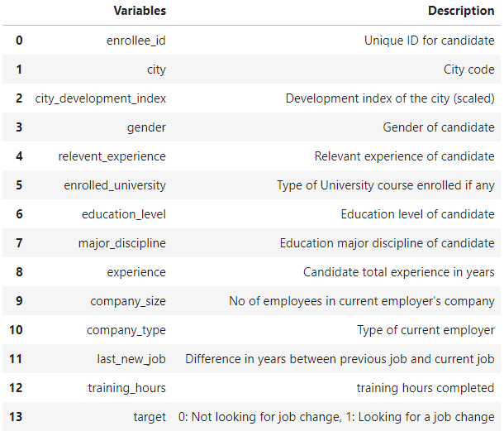
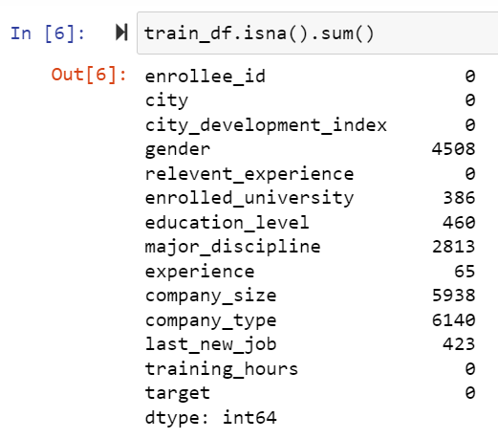
EDA|Evaluate the shape and split of the training data
Data Split:
Switch Job: 4777
Stay at Job: 14381

Slide 5
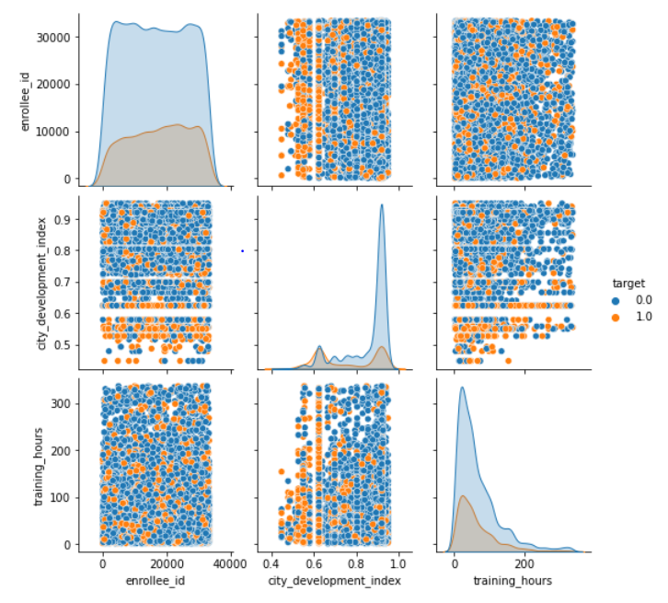
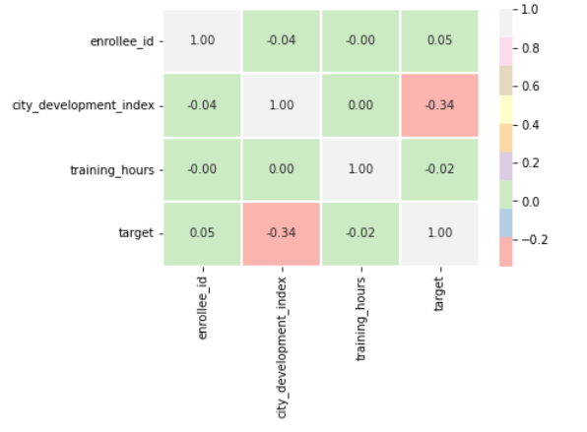
EDA|Identify the correlation between all the attributes

Slide 6
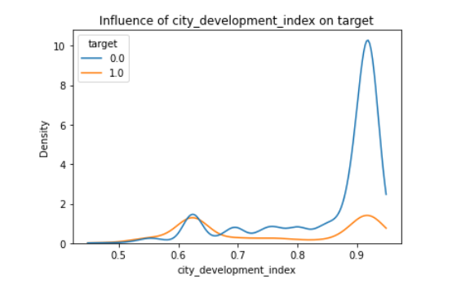
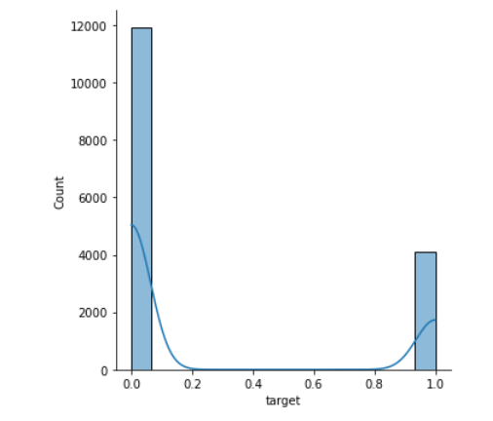
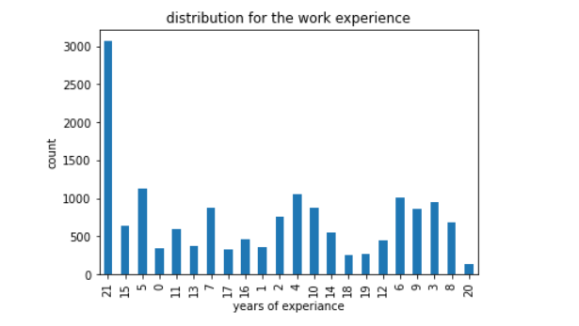
EDA|Distribution of select attributes

Slide 7
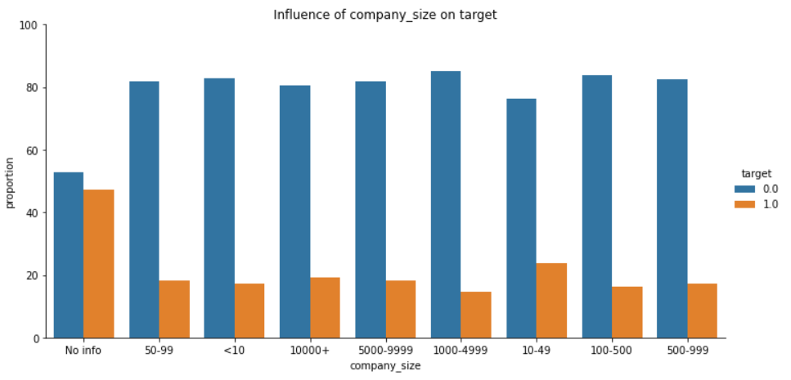
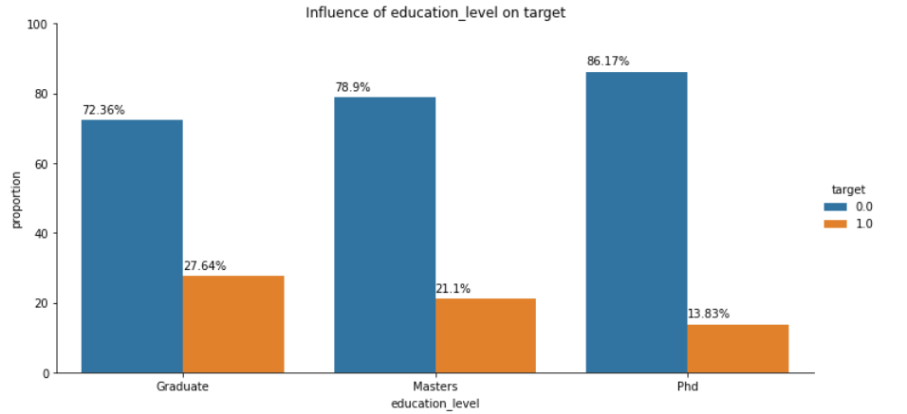
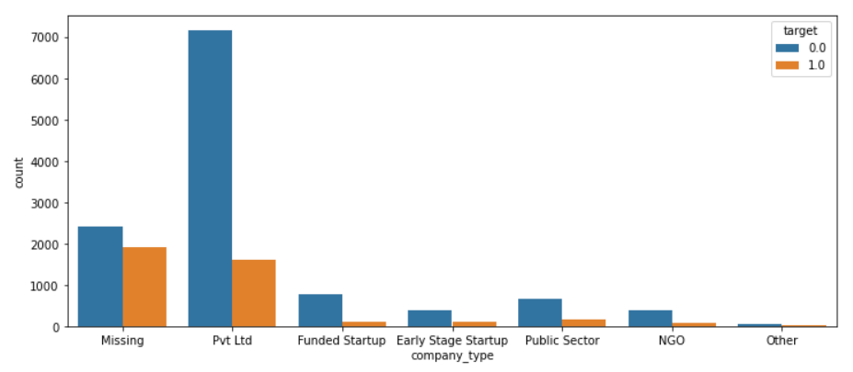
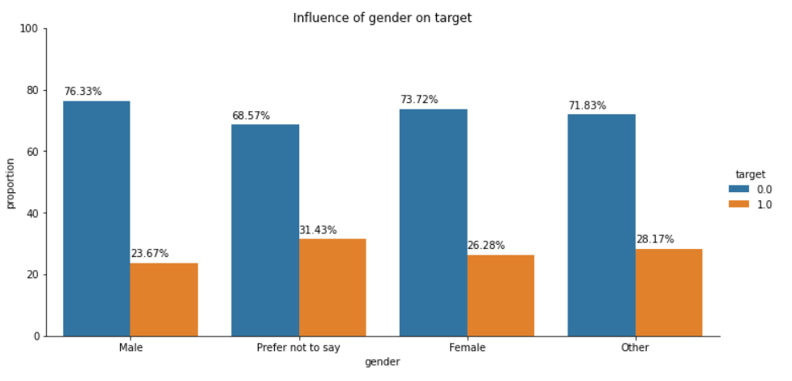
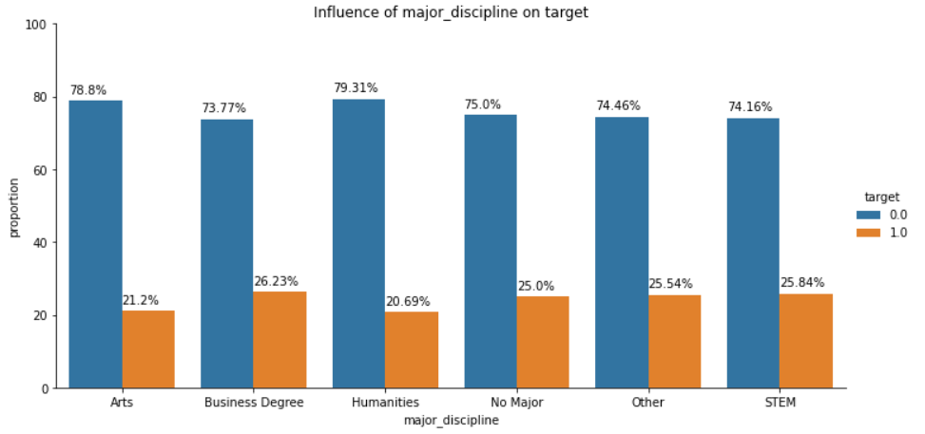
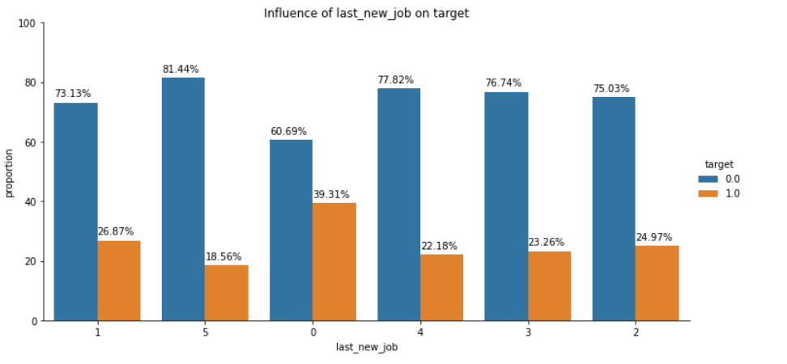
EDA| Relevant features attributed to changing of a job

Slide 8
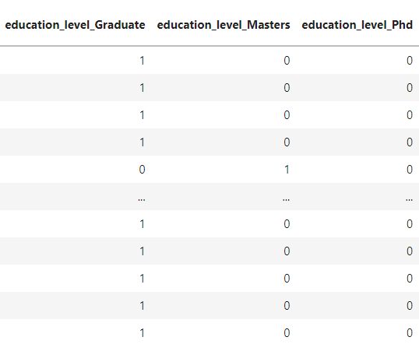
Data Preprocessing|Data has been cleaned and processed for modelling
Dropped enrollee_id, city, company_size
Provided minimal relevance
MinMaxScaler() on measure columns to allow for normal distribution / reduce outliers
One_hot_encoding() to turn our dimensions (non-numeric) in to boolean values
For the purpose of interpretability by our classification models
Oversampling using SMOTE() to assure equal observations of target = 0 and target = 1

Slide 9
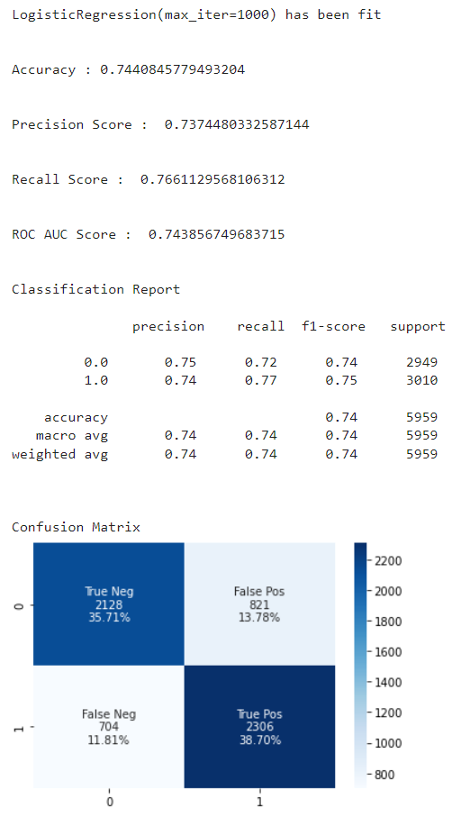
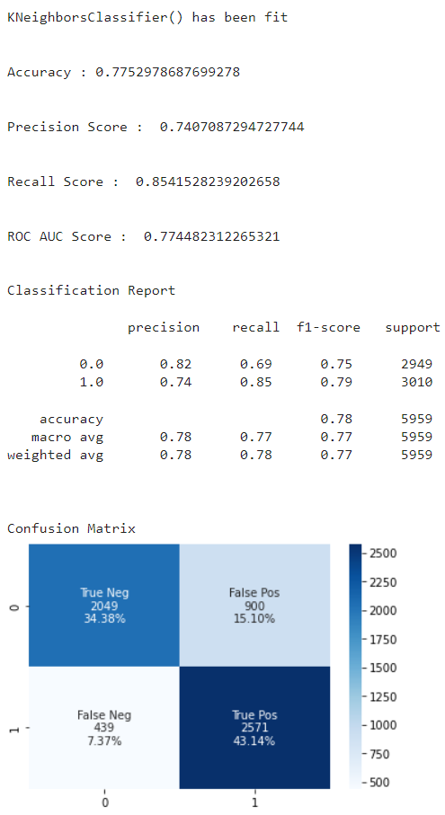
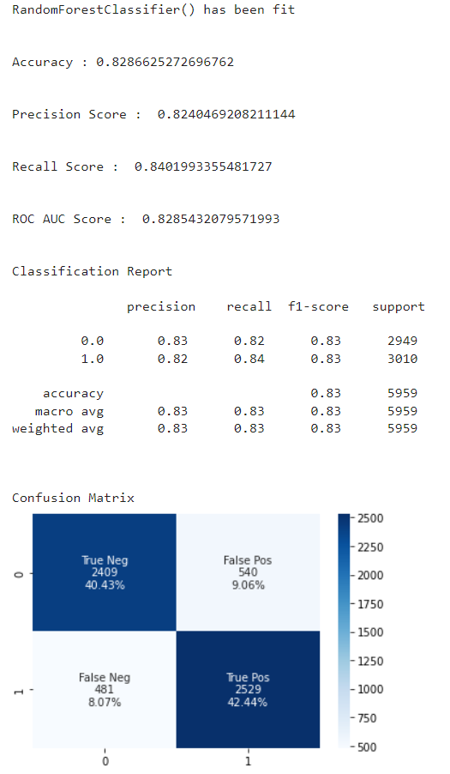
Modeling|3 models under consideration: RF, KNN, Logistic Regression
Notes:
Logistic Regression- Parametric
KNN,RF - Non-parametric

Slide 10
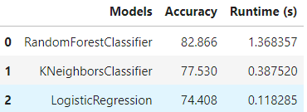
Modeling| Random Forest Classifier is the best model for our use-case
Random Forest:
Considered only default params
Found no need for hyper parameter tuning
Set huge and we were pleased with the results

Slide 11

Conclusion|
Most important attributes: city development index, training hours, and last new job
Less important attributes: experience, gender
RF Classifier was most beneficial / accurate model

Slide 12
Questions?

